Slide 1

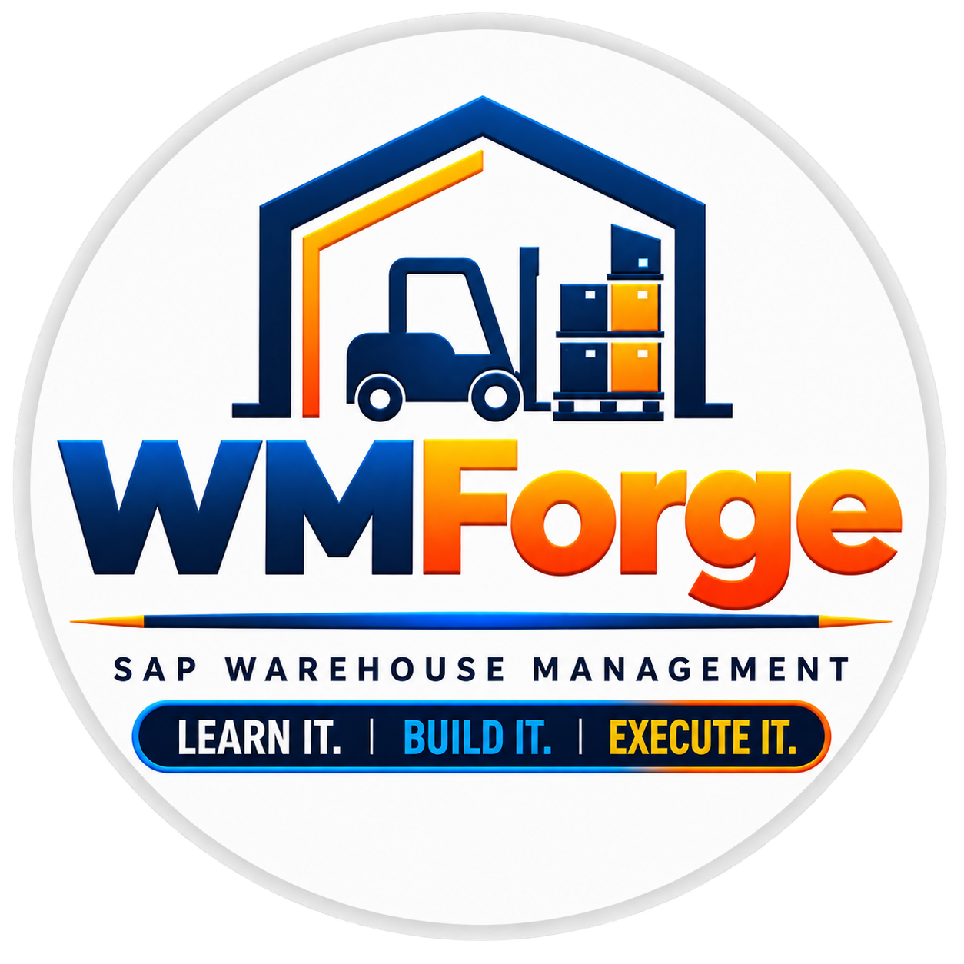
SAP WAREHOUSE MANAGEMENT
PHYSICAL INVENTORY COUNTING PROCESS
From creating the PID to posting the inventory difference.
LI01N
CREATE PID
LI04N
PRINT PID
LI11N
ENTER COUNT
LI14
INITIATE RECOUNT
LI20
CLEAR DIFFERENCE
LI21
POST DIFFERENCE
WMForge • SAP Warehouse Management

Slide 2
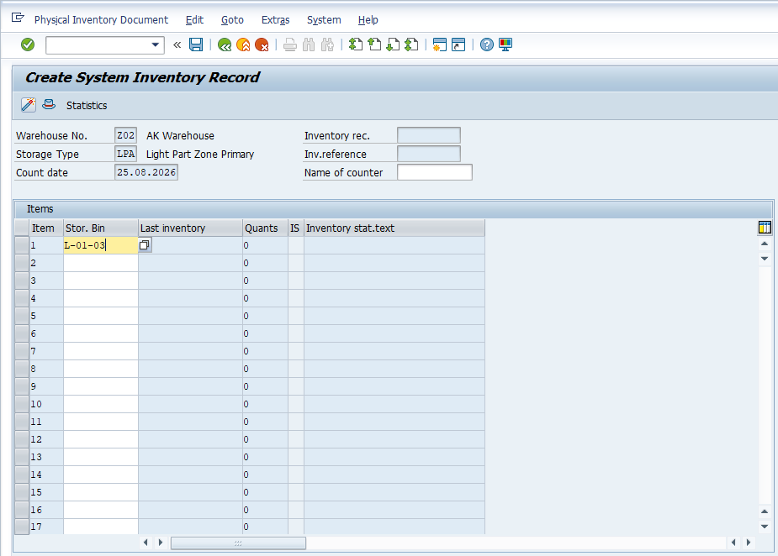
STEP 01
CREATE THE PHYSICAL INVENTORY DOCUMENT
LI01N
The Physical Inventory process starts by creating a Physical Inventory document using LI01N.
SAP captures and freezes the current book inventory for the selected storage bin.
By default, SAP blocks the storage bin for inventory movements once the Physical Inventory Document is created.
SAP SCREEN • CREATE SYSTEM INVENTORY RECORD
WMForge • SAP Warehouse Management • LI01N • CREATE PID

Slide 3
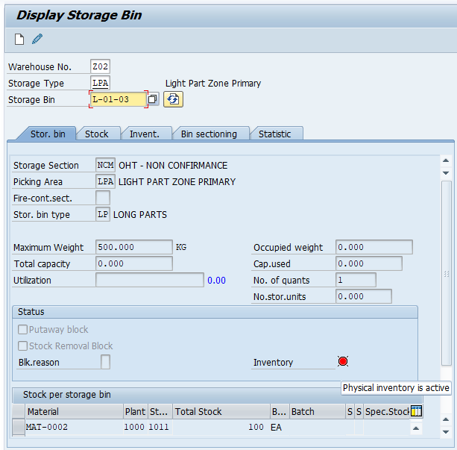
CONTROL POINT
BIN BLOCK — MOVEMENTS ARE NOT ALLOWED
The block protects the physical count from warehouse movements changing the stock during counting.
STORAGE BIN • BLOCK / INVENTORY STATE
WHILE THE BIN IS BLOCKED
× NO PUTAWAY Stock cannot be put away into the blocked bin.
× NO PICKING Stock cannot be picked from the blocked bin.
× NO BIN-TO-BIN No internal bin transfer is allowed.
TRANSFER
× NO POSTING No posting change is allowed while blocked.
CHANGE
WMForge • SAP Warehouse Management • BIN CONTROL

Slide 4
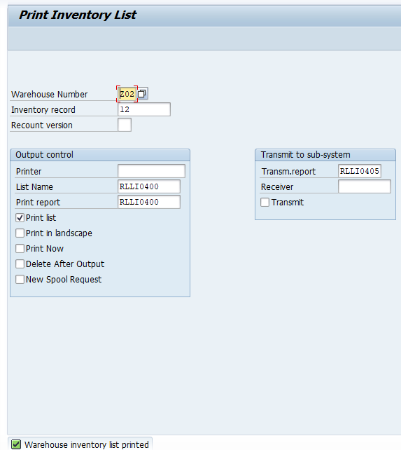
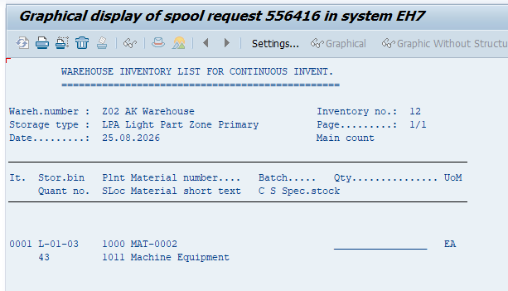
STEP 02
PRINT / PROVIDE THE COUNT SHEET
The activated PID becomes the operator's working sheet for the physical count.
LI04
LI04N • PRINT INVENTORY LIST
PRINTED INVENTORY LIST • COUNT SHEET
WHAT THE OPERATOR USES
The warehouse operator uses the activated PID/count sheet to physically count the stock in the warehouse.
Note:-
Count the physical quantity carefully — do not assume the system quantity is correct.
WMForge • SAP Warehouse Management • LI04N • COUNT SHEET

Slide 5
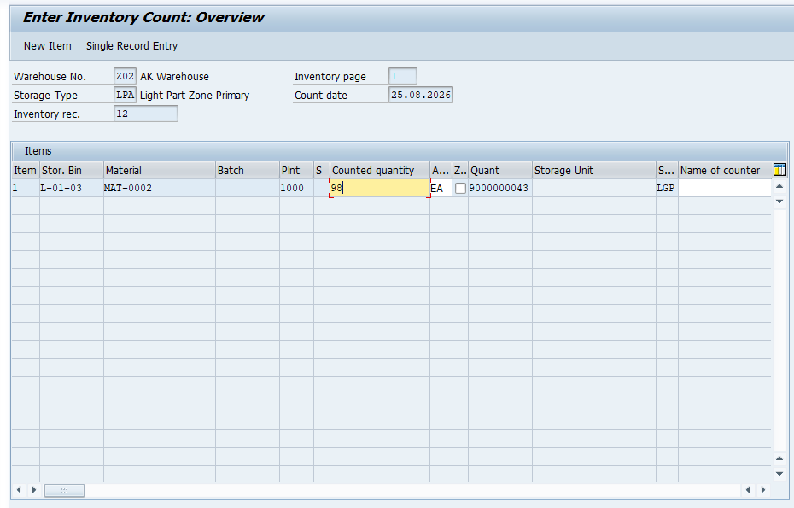
STEP 03
ENTER THE PHYSICAL COUNT
Once the operator completes the physical count, the result is entered in LI11N.
LI11N
SAP SCREEN • ENTER INVENTORY COUNT
OPERATOR ACTION
Then warehouse operator performs the physical count. The count is then entered in LI11N.
DECISION POINT
If the entered count does not match the expected stock, the inventory difference becomes part of the reinitiate process.
WMForge • SAP Warehouse Management • LI11N • ENTER COUNT

Slide 6
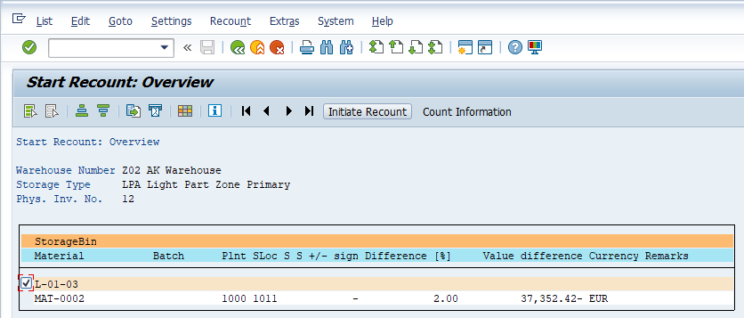
STEP 04
RECOUNT WHEN VERIFICATION IS NEEDED
A recount provides a controlled second check when the initial count is incorrect or needs verification.
LI14
WHEN TO USE IT
If the initial count is incorrect or needs verification, a recount is then initiated using LI14.
LI14 • START RECOUNT OVERVIEW
KEY RULE
Recount → confirm the physical quantity → continue only when the difference is understood.
WMForge • SAP Warehouse Management • LI14 • RECOUNT

Slide 7
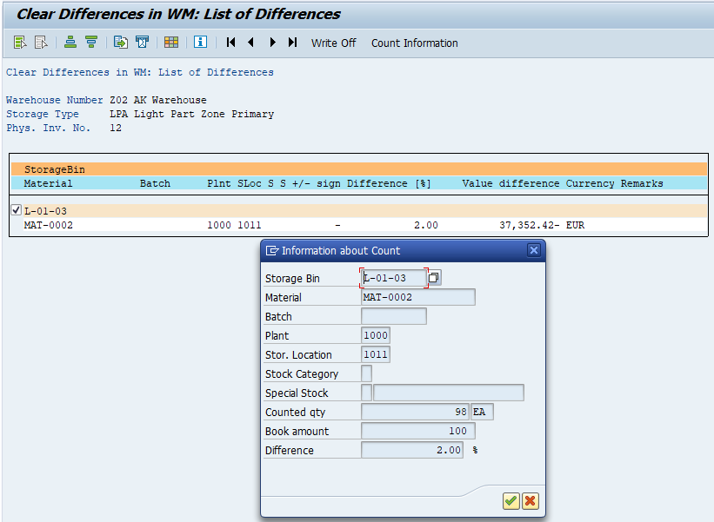
STEP 05
CLEAR THE INVENTORY DIFFERENCE IN WM
After a confirmed recount, LI20 is used to clear the difference within Warehouse Management.
LI20
LI20 • CLEAR DIFFERENCES IN WM
WM ACTION
If the recount confirms an inventory difference, the difference is cleared in WM using LI20.
CONTROL CHECK
Confirm the difference before clearing it. The WM clearing step prepares the result for the final IM posting.
CONFIRMED DIFFERENCE
WMForge • SAP Warehouse Management • LI20 • CLEAR WM DIFFERENCE

Slide 8
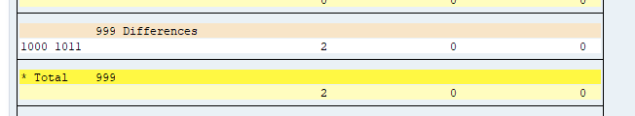
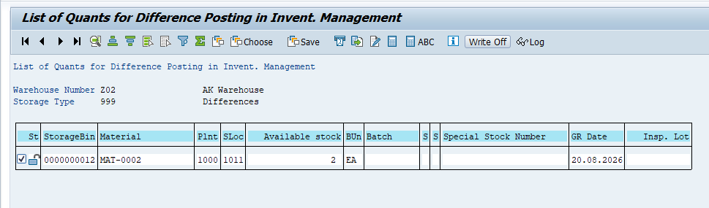
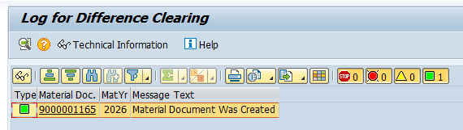
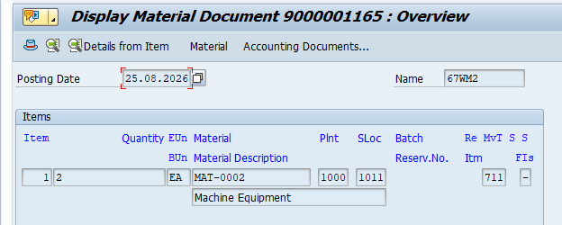
STEP 06
POST THE DIFFERENCE TO INVENTORY MANAGEMENT
LI21 moves the cleared WM difference into Inventory Management (IM).
LI21
FINAL SYSTEM POSTING
Finally, LI21 is used to post the inventory differences (if any) from WM to Inventory Management (IM).
LI21 • DIFFERENCE POSTING
KEY RULE
WM difference cleared → IM posting → material document created.
POSTING LOG
MATERIAL DOCUMENT
WMForge • SAP Warehouse Management • LI21 • POST TO IM

Slide 9
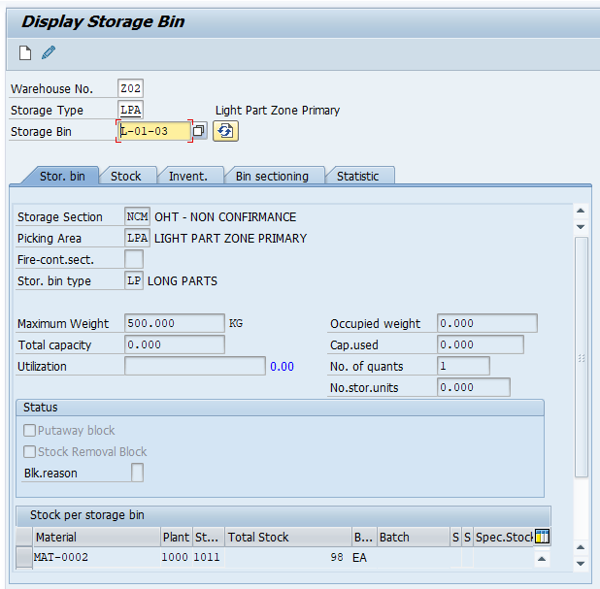
PROCESS COMPLETE
THE BIN IS RELEASED FOR NORMAL OPERATIONS
After the physical inventory process is completed, SAP removes the inventory block.
FINAL STORAGE BIN STATE
WHAT CHANGES
After the physical inventory process is completed SAP removes the inventory block, and the bin becomes available for normal warehouse operations again.
✓ BLOCK REMOVED Inventory movements can resume.
✓ BIN AVAILABLE Normal warehouse operations continue.
✓ PROCESS CLOSED Physical count is reconciled in SAP.
WMForge • SAP Warehouse Management • PROCESS COMPLETE

